Slide 1
ANALOG TO DIGITAL CONVERTER (ADC)

Slide 2
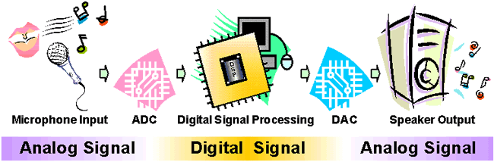
WHY SHOULD I LEARN ADC ??
What it does ?
It is a device which converts analog input to digital output
Everything that is present in the physical world is analog and continuous such as the temperature around us, light, humidity, velocity ,sound.
But the digital world comprising the microcontrollers and processors need binary data to process a given information.
What we get is analog but we need digital data to process it. Now, this is why we need an Analog-to-Digital Converter.

Slide 3

APPLICATIONS
Analog –to- digital Converters are among the most widely used devices used for data acquisition.
Proximity sensor.
Digital thermometers.
Microphone.

Slide 4
Characteristics of an ADC
Range
The smallest to largest value an instrument can measure
Eg – 0-5 V range voltmeter, 1.0 to 2.0 mA range ammeter
Resolution
The resolution of the converter indicates the number of discrete values it can produce over the range of analog values.
Higher the resolution , higher the accuracy.
If range is 0-5 V and has a resolution of 20 steps then it can detect changes greater then (5-0)/20=0.2 V(this smallest difference is also called step size)

Slide 5
TYPES OF ADC
COUNTER TYPE
INTEGRATING OR DUAL SLOPE
PARALLEL OR FLASH
SUCCESSIVE APPROXIMATION(used by Arduino)

Slide 6
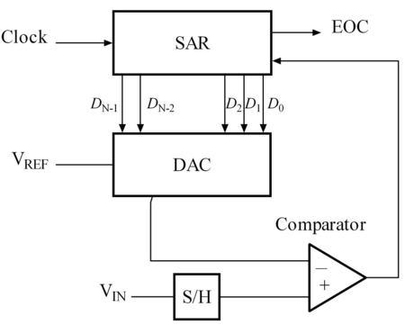
Successive Approximation ADC

Slide 7
Hardware Connection
AVCC provides the power supply for the analog ADC circuitry. To get a better accuracy of AVR ADC we must provide a stable voltage source to the AVCC pin. This is done by connecting a capacitor (10 -20 pF) between AVCC and GND.
By connecting a capacitor (10 -20 pF) between AVREF and GND we can make the V_{ref} voltage more stable and increase the precision of the ADC.

Slide 8
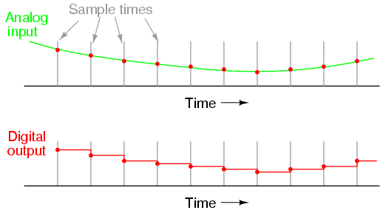
Data losses

Slide 9
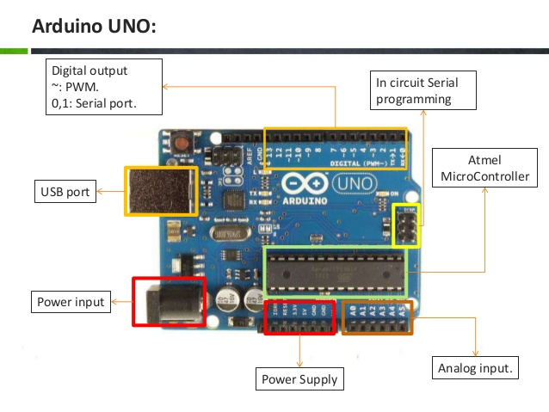
Choosing Factors of Arduino ADC
Range
The reference voltage (V_{ref}) is the maximum value that the ADC can convert. For example 8-bit ADC can convert values from 0V to V_{ref} .
It depends upon what pin you select from Arduino’s power supply port

Slide 10
Choosing Factors of Arduino ADC
Resolution
10 bit type resolver gives a resolution of 2^10=1024 step hence the step size is given as - Step Size = (V_{ref} - 0)/ 1024 , (where V_{ref} is 3.3 V or 5V depending the pin u select from Arduino)

Slide 11
Register
Each register has control over certain part of Arduino’s ADC
In the AVR microcontroller 4 major registers are associated with the ADC.
ADC Control and Status Register - ADCSRA
ADC Multiplexer(V_{ref} select and port select ) Register - ADMUX
ADC data storing register - ADCH and ADCL

Slide 12
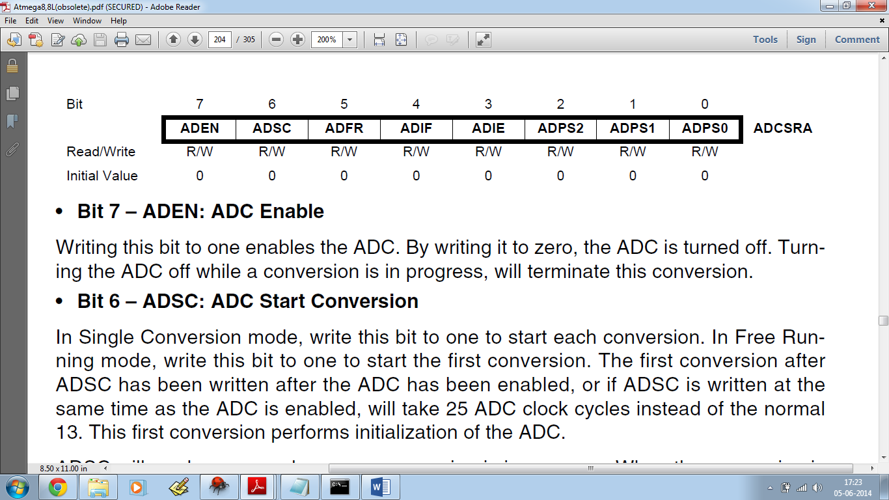
ADCSRA
ADC Enable - ADEN
Set this pin to 1 to enable ADC.
Like this - ADCSRA |= (1 << ADEN) ;
ADC Start Conversion - ADSC
Set this bit high before start of any conversion. After conversion is complete is set back to 0 automatically.
ADC Interrupt Flag - ADIF
When conversion is finished, it is set to 1. Thus it can be used to check if the conversion is completed or not.

Slide 13
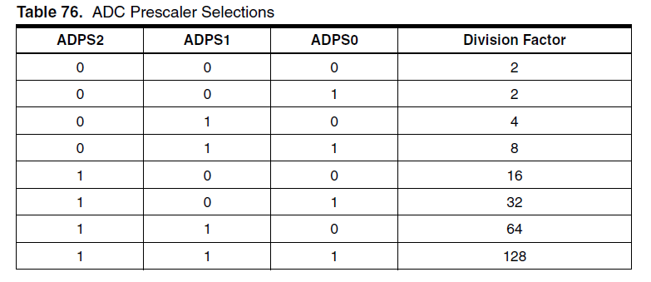
ADC prescaling – ADPS(0:2)
To select prescaler - ADCSRA |= (n<< ADPS2) | (n << ADPS1) | (n<< ADPS0)); , where n can be 0 or 1

Slide 14
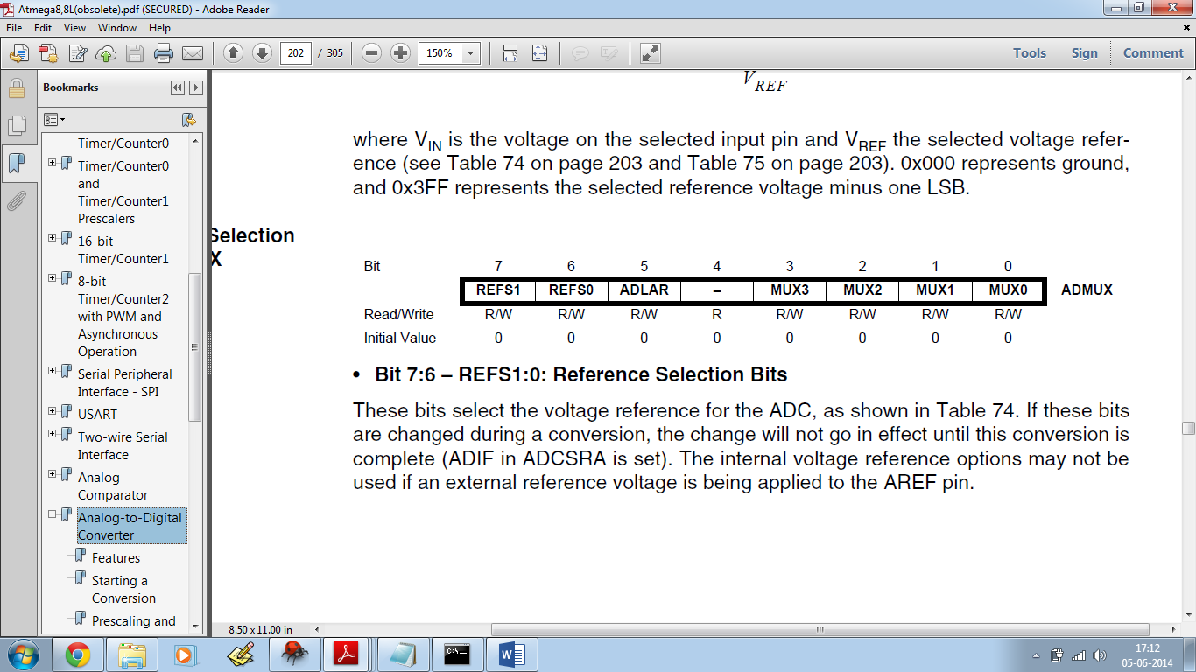
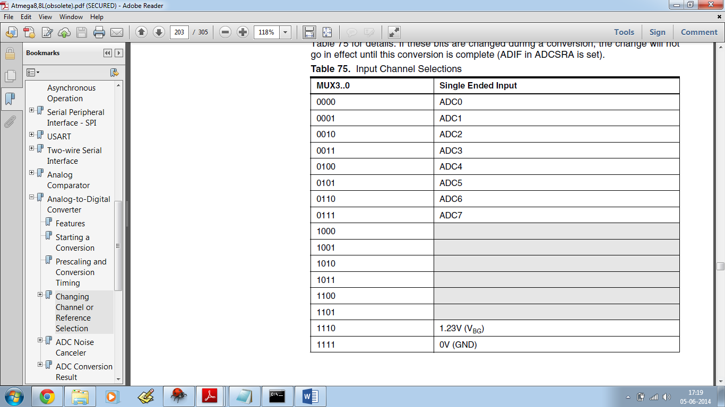
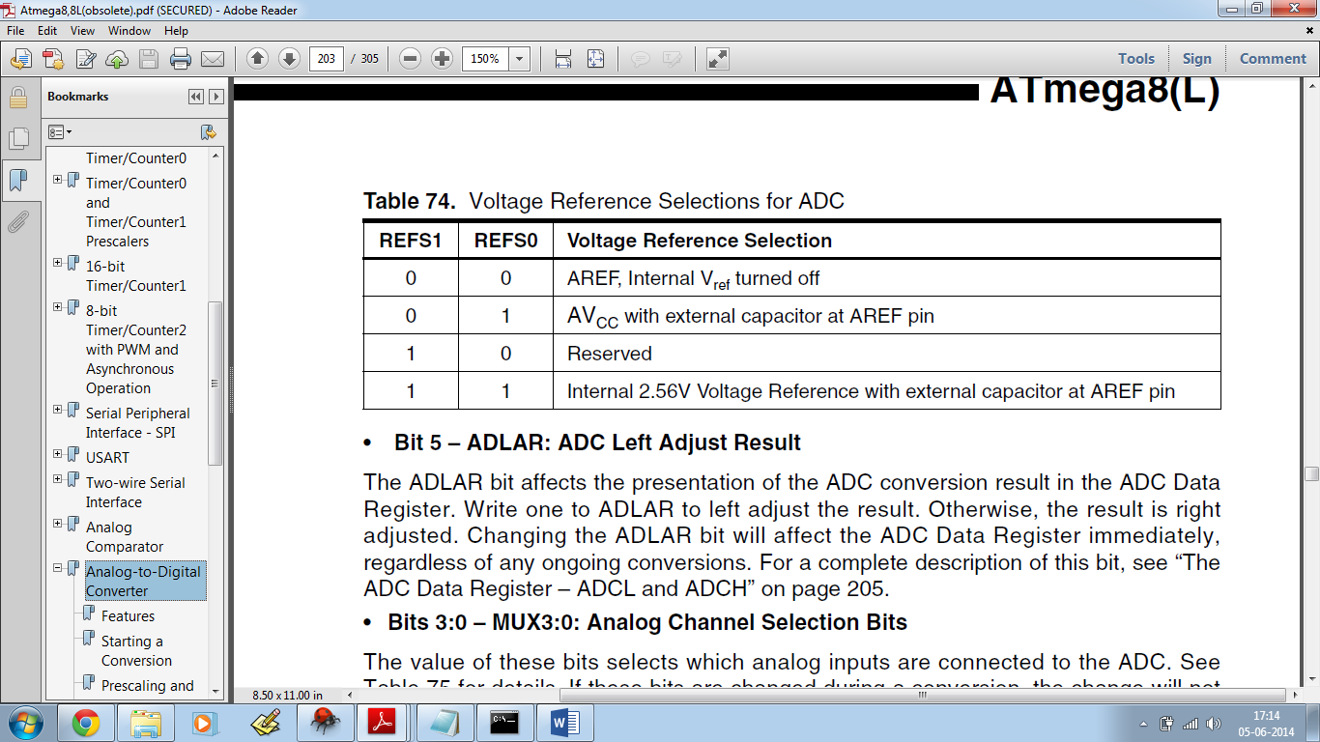
ADMUX
ADC V_{ref} select - REFS(0:1)
Set it as per table given below to select V_{ref}
ADC port select – MUX(0:3)
Set as per table given at right to select input pin

Slide 15
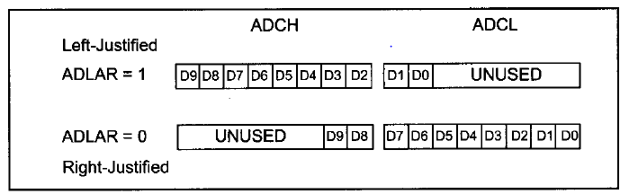
ADLAR
The AVR has 10 bit ADC, which means that the result is 10 bits long and cannot be stored in a single register. Thus in AVR two 8 bit registers are used to store the ADC value. But only 10 of the 16 bits are used. So the values can be either left justified(ADLAR=1) or right justified(ADLAR=0).
By default it is zero
ADCH - ADC High data Register, ADCL - ADC Low data Register

Slide 16
Sample code
ADC Initialization
void ADC_init ()
{
ADCSRA |= (1<<ADEN) | (1<<ADPS2) | (1<<ADPS1) | (1<<ADPS0); // prescalar of 128
ADMUX |= (1<<REFS0) ; // A_{ref} = V_{cc}
}

Slide 17
Reading ADC Value
uint16_t ADC_read()
{
ADCSRA|=(1<<ADSC); // start conversion
while( (ADCSRA & (1<<ADIF) )==0)
{ // wait till ADC conversion takes place
}
ADCSRA |= (1<<ADIF); //reset interrupt flag
return (ADC);
}

